Slide 1
History Heroes Term 1, Week 4
https://www.youtube.com/watch?v=lXgkuM2NhYI 0.50-1.00

Slide 2
Question 1 (1 mark)
Who was Henry Ford?

Slide 3
Question 2 (1 mark)
Who was Theodore Roosevelt?

Slide 4
Question 3 (1 mark)
Who was William Taft?

Slide 5
ANSWERS

Slide 6
Question 1 (1 mark)
Who was Henry Ford?

Slide 7
Question 2 (1 mark)
Who was Theodore Roosevelt?

Slide 8
Question 3 (1 mark)
Who was William Taft?

Slide 9
ANSWERS

Slide 10
Question 1 (1 mark)
Who was Henry Ford?
A businessman who established the Ford Motor Company.

Slide 11
Question 2 (1 mark)
Who was Theodore Roosevelt?
26th President of US

Slide 12
Question 3 (1 mark)
Who was William Taft?
27th President of US

Slide 13
Total
/3

Slide 14


Source
of
the
week!

Slide 15
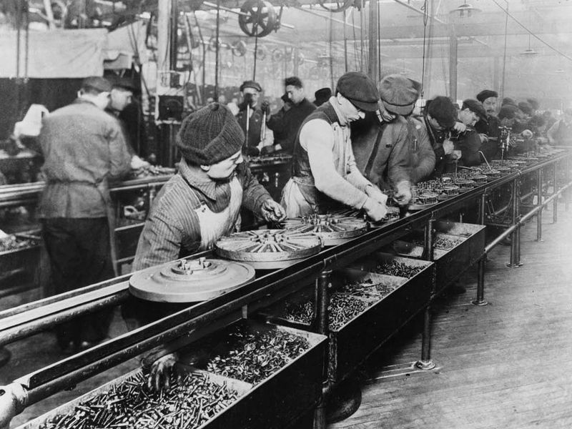
The Ford Assembly Line, 1913
https://www.smithsonianmag.com/smart-news/one-hundred-and-three-years-ago-today-henry-ford-introduced-assembly-line-his-workers-hated-it-180961267/

